Slide 1
Chapter 4:
Basic Local Alignment Sequence Tool (BLAST)
Jonathan Pevsner, Ph.D.
pevsner@kennedykrieger.org
Bioinformatics and Functional Genomics
(Wiley-Liss, 3rd edition, 2015)
You may use this PowerPoint for teaching purposes

Slide 2
Outline
Introduction
BLAST search steps
Step 1: Specifying Sequence of interest Step 2: Selecting BLAST Program Step 3: Selecting a Database Step 4: Selecting Search Parameters and Formatting Parameters
Stand-Alone BLAST
BLAST algorithm uses local alignment search strategy
BLAST algorithm parts: list, scan, extend BLAST algorithm: local alignment search statistics and E value
Making sense of raw scores with bit scores BLAST algorithm: Relation Between E and p values
BLAST search strategies General concepts; principles of BLAST searching
How to evaluate the significance of results How to handle too many or few results
BLAST searching with multidomain protein: HIV-1 Pol
Using BLAST for gene discovery: Find-a-Gene
Perspective

Slide 3
Learning objectives
• perform BLAST searches at the NCBI website;
• understand how to vary optional BLAST search parameters;
• explain the three phases of a BLAST search (compile, scan/extend, trace‐back); • define the mathematical relationship between expect values and scores; and
• outline strategies for BLAST searching.

Slide 4
BLAST
BLAST (Basic Local Alignment Search Tool) allows rapid sequence comparison of a query sequence against a database.
The BLAST algorithm is fast, accurate, and accessible both via the web and the command line.

Slide 5
Why use BLAST?
BLAST searching is fundamental to understanding
the relatedness of any favorite query sequence
to other known proteins or DNA sequences.
Applications include
identifying orthologs and paralogs
discovering new genes or proteins
discovering variants of genes or proteins
investigating expressed sequence tags (ESTs)
exploring protein structure and function

Slide 6
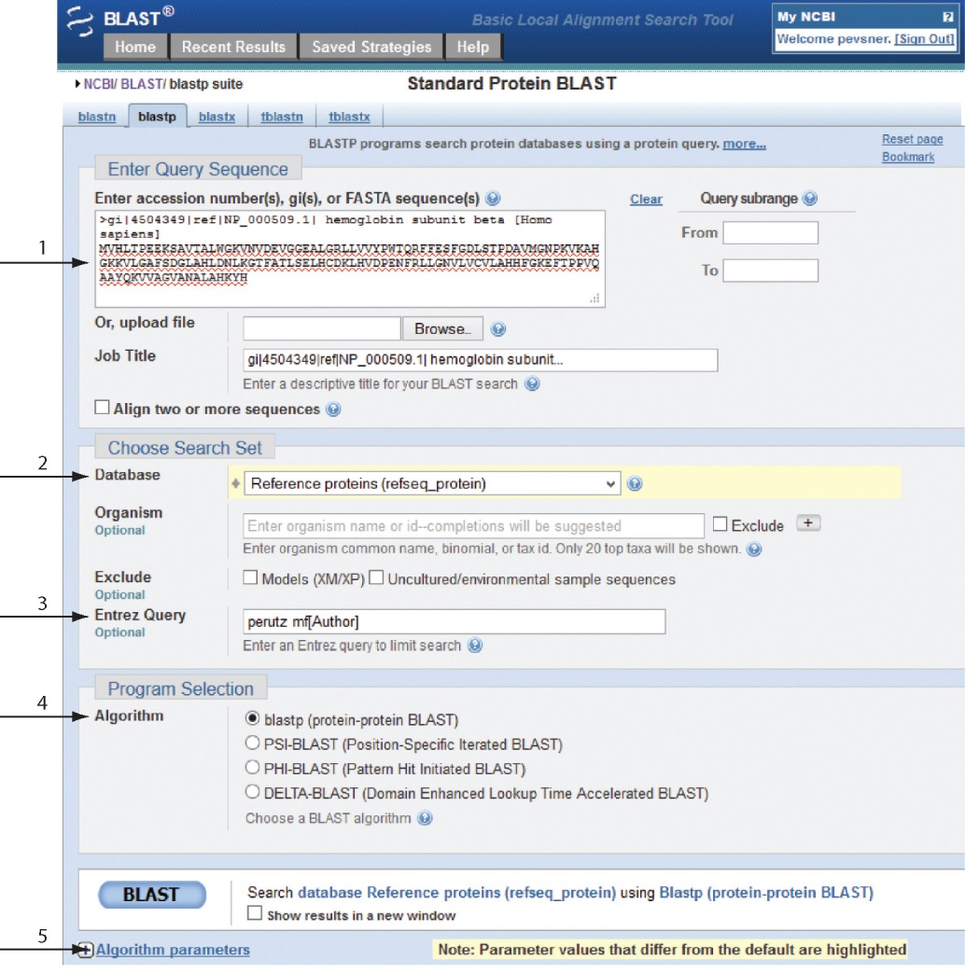
BLASTP search at NCBI: overview of web-based search
query: FASTA format or accession
database
Entrez query
algorithm
B&FG 3e
Fig. 4-1
Page 123
parameters

Slide 7
Outline
Introduction
BLAST search steps
Step 1: Specifying sequence of interest Step 2: Selecting BLAST program Step 3: Selecting a database Step 4: Selecting search parameters and formatting parameters
Stand-alone BLAST
BLAST algorithm uses local alignment search strategy
BLAST algorithm parts: list, scan, extend BLAST algorithm: local alignment search statistics and E value
Making sense of raw scores with bit scores BLAST algorithm: relation between E and p values
BLAST search strategies General concepts; principles of BLAST searching
How to evaluate the significance of results How to handle too many or too few results
BLAST searching with multidomain protein: HIV-1 Pol
Using BLAST for gene discovery: Find-a-Gene
Perspective

Slide 8
Step 1: Choose your sequence
Sequence can be input in FASTA format or as accession number

Slide 9
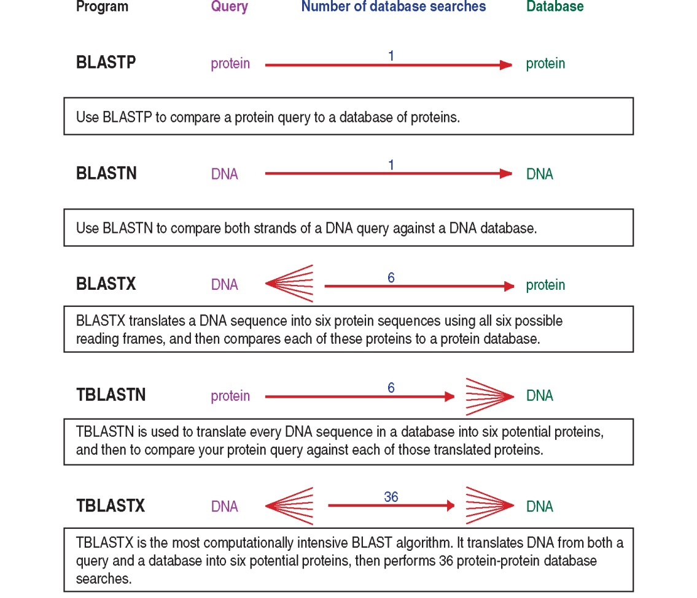
BLAST step 2: choose program
B&FG 3e
Fig. 4-2
Page 124

Slide 10
Step 2. Choose the BLAST program
Program Input Database
1
blastn DNA DNA
1
blastp protein protein
6
blastx DNA protein
6
tblastn protein DNA
36
tblastx DNA DNA

Slide 11
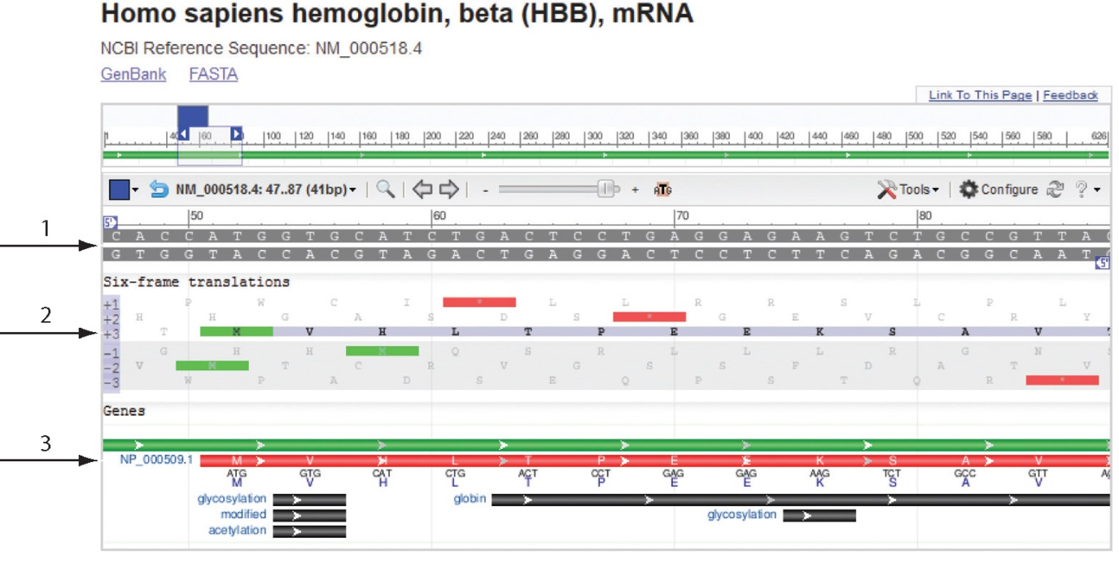
Step 2 (choosing the BLAST program):
DNA can be translated into six reading frames
DNA
3 forward,
3 reverse
frames
protein
B&FG 3e
Fig. 4-3
Page 125
This image is from the NCBI Nucleotide entry for HBB

Slide 12
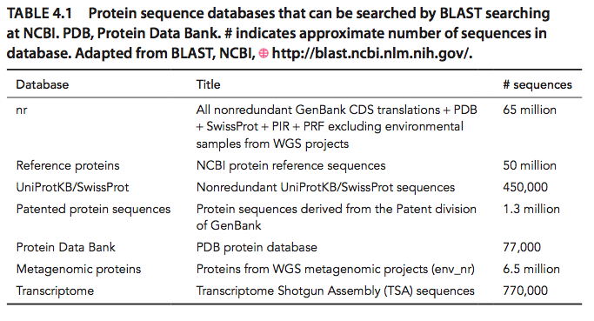
Step 3: choose a database to search (protein databases)
B&FG 3e
Table 4-1
Page 126

Slide 13
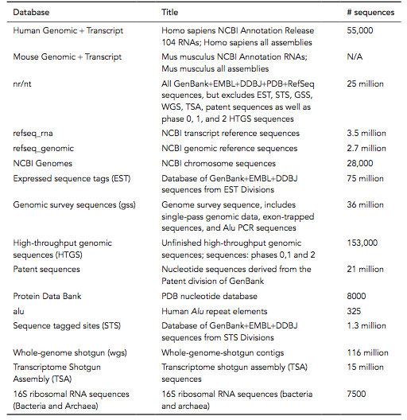
Step 3: choose a database to search (nucleotide)
B&FG 3e
Table 4-2
Page 127

Slide 14
Step 4: optional parameters
You can...
• choose the organism to search
• turn filtering on/off
• change the substitution matrix
• change the expect (e) value
• change the word size
• change the output format
Example: BLASTP human insulin (NP_000198) against a C. elegans RefSeq database. Varying some parameters (filtering, compositional adjustments) can greatly affect the alignment itself.

Slide 15
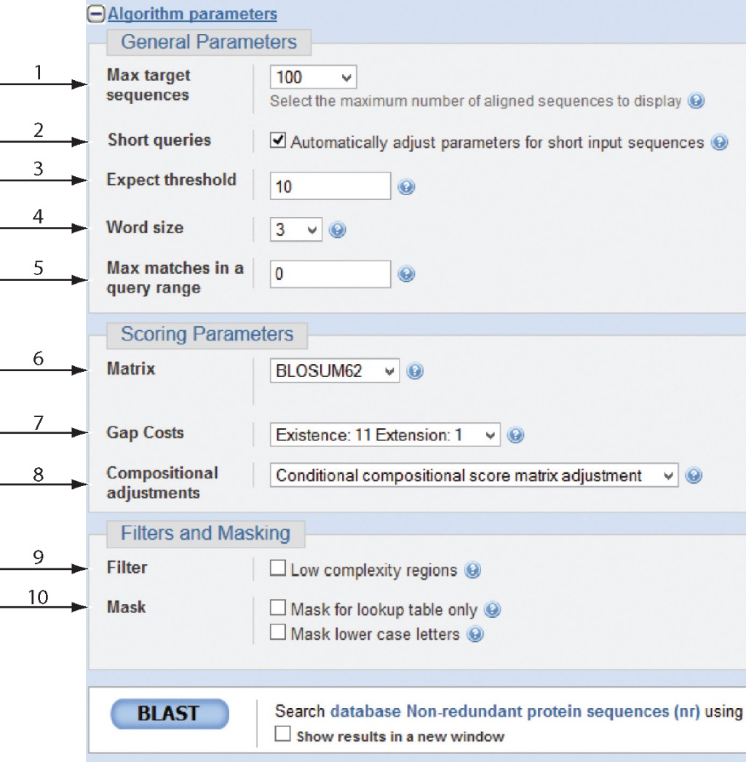
Step 4a: choose optional BLASTP search parameters
max sequences
short queries
expect threshold
word size
max matches
scoring matrix
gap costs
compositional adjustment
filter
mask
B&FG 3e
Fig. 4-4
Page 128

Slide 16
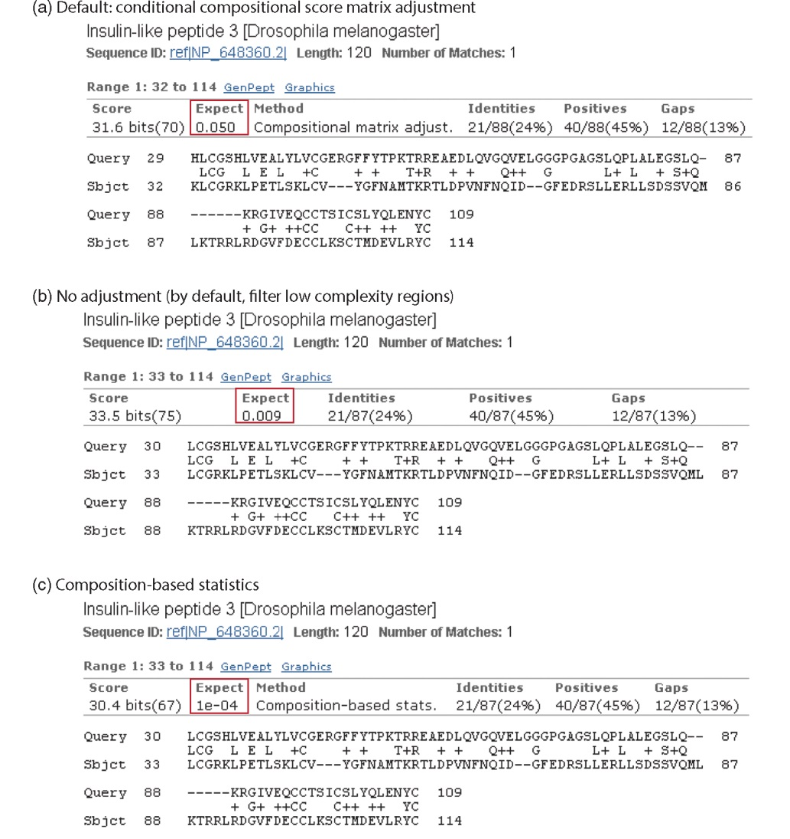
Step 4a: compositional adjustment influences score, expect value search results
expect = 0.05
Default: conditional compositional score matrix adjustment
expect = 0.09
no adjustment
expect = 1e-04
B&FG 3e
Fig. 4-5
Page 129
composition-based statistics

Slide 17
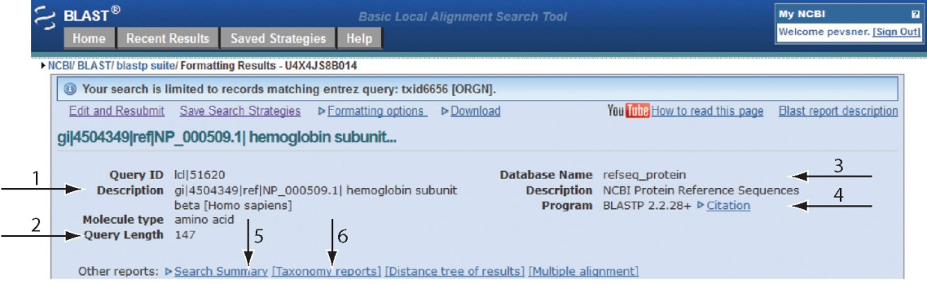
Step 4b: formatting options
The top of the BLAST output summarizes the query, database, and BLAST algorithm.
Click to access a summary of the search parameters or a taxonomic report.
B&FG 3e
Fig. 4-6
Page 132

Slide 18
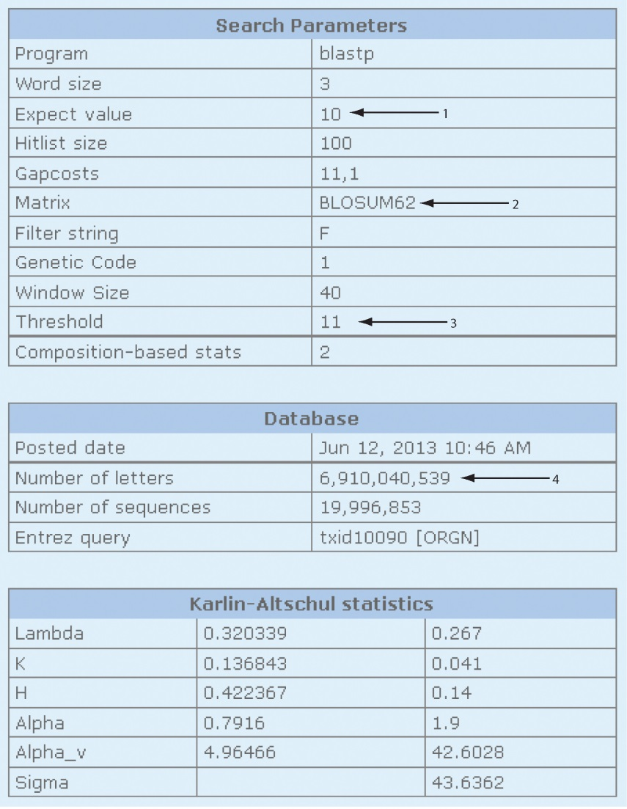
Step 4b: formatting options (you can view search parameters)
Expect value
BLOSUM62 matrix
Threshold value T
Size of database
B&FG 3e
Fig. 4-7
Page 133

Slide 19
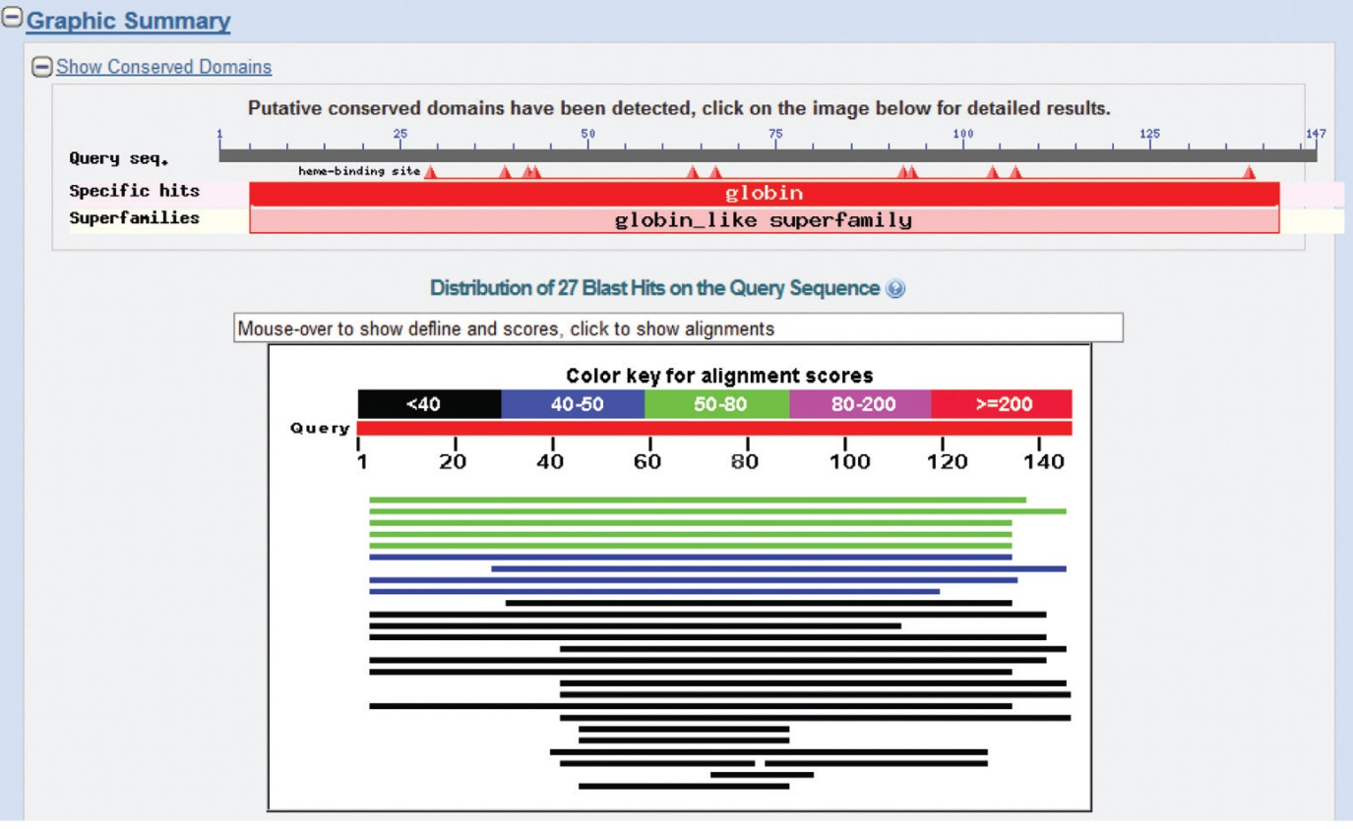
Step 4b: formatting options
Graphic summary of the results shows the alignment scores (coded by color) and the length of the alignment (given by the length of the horizontal bars)
B&FG 3e
Fig. 4-8
Page 134

Slide 20
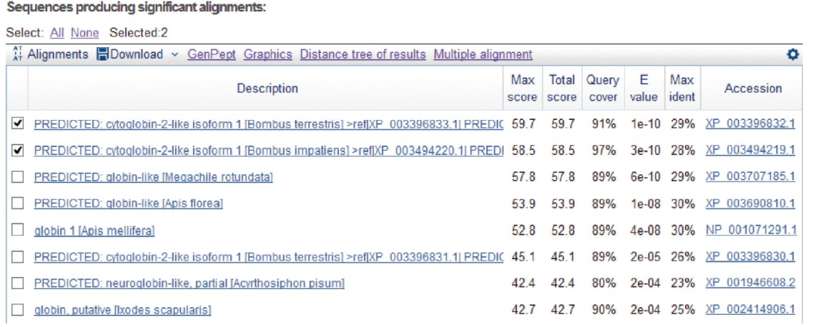
BLASTP output includes list of matches; links to the NCBI protein entry; bit score and E value; and download options
B&FG 3e
Fig. 4-9
Page 134

Slide 21
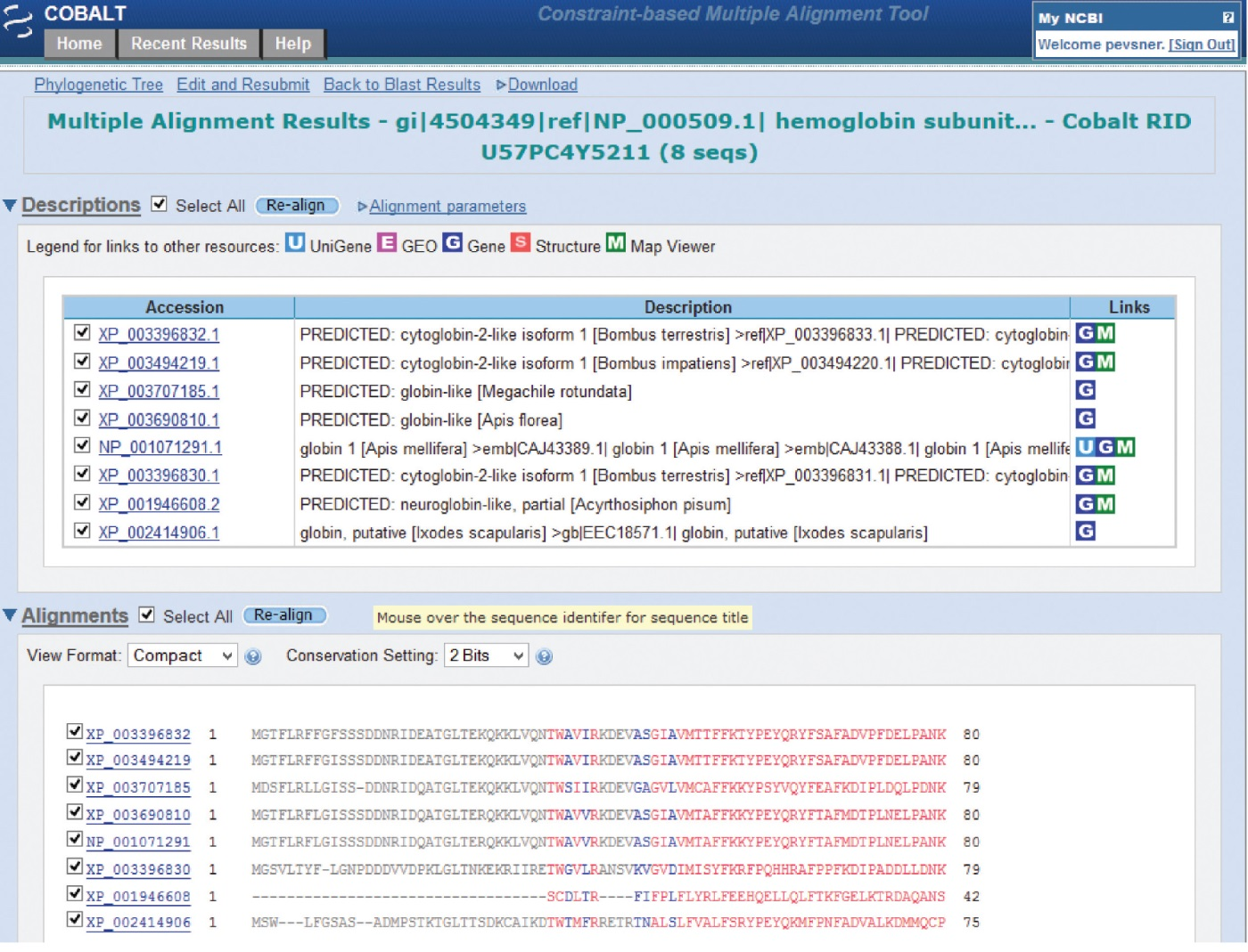
BLAST output can be formatted to display multiple alignment
B&FG 3e
Fig. 4-10
Page 135

Slide 22
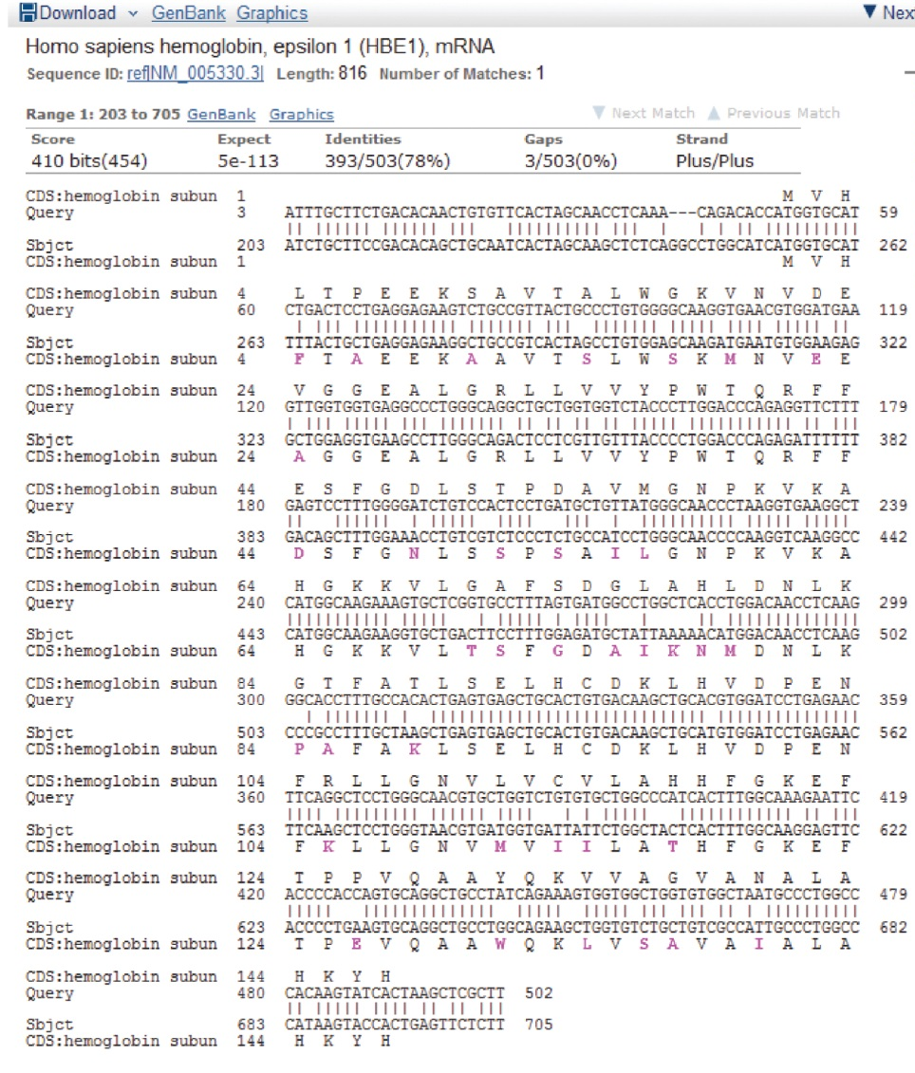
For BLASTN, CDS output displays amino acids above DNA sequence of query and subject
B&FG 3e
Fig. 4-11
Page 136

Slide 23
Outline
Introduction
BLAST search steps
Step 1: Specifying sequence of interest Step 2: Selecting BLAST program Step 3: Selecting a database Step 4: Selecting search parameters and formatting parameters
Stand-alone BLAST
BLAST algorithm uses local alignment search strategy
BLAST algorithm parts: list, scan, extend BLAST algorithm: local alignment search statistics and E value
Making sense of raw scores with bit scores BLAST algorithm: relation between E and p values
BLAST search strategies General concepts; principles of BLAST searching
How to evaluate the significance of results How to handle too many or too few results
BLAST searching with multidomain protein: HIV-1 Pol
Using BLAST for gene discovery: Find-a-Gene
Perspective

Slide 24
Command-line BLAST+
Visit the BLAST site at NCBI (“help” tab) to find the URL for the BLAST+ download.
Three steps:
Obtain a protein database (we’ll use a perl script included in the BLAST+ installation);
Obtain a query protein (we’ll use EDirect);
Perform the search
B&FG 3e
Page 137

Slide 25
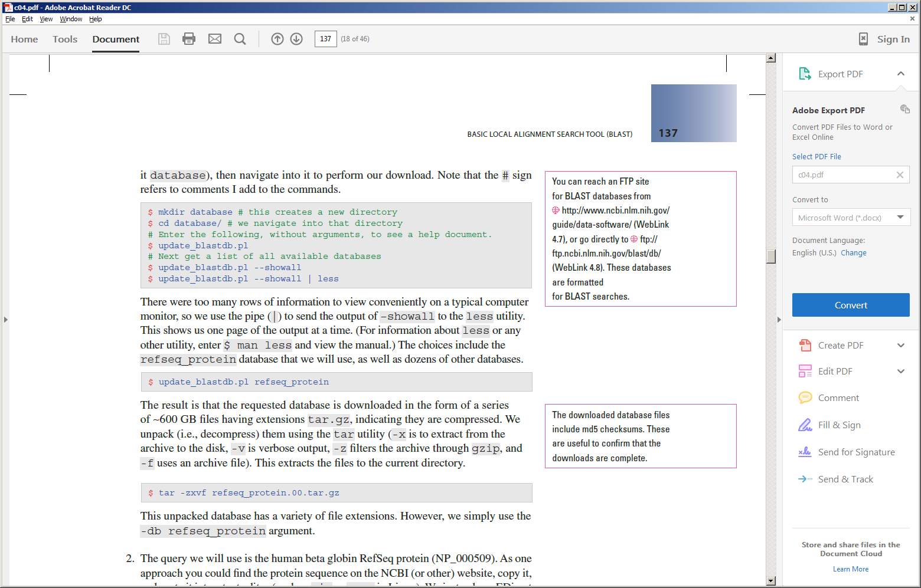
Command-line BLAST+ (Step 1: obtain a database)
Visit the BLAST site at NCBI (“help” tab) to find the URL for the BLAST+ download.
B&FG 3e
Page 137

Slide 26
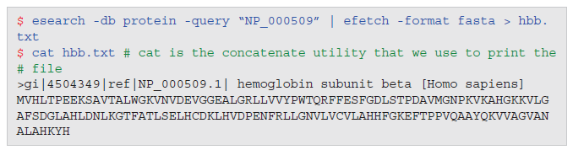
Command-line BLAST+ (Step 2: obtain a query protein)
Use EDirect to obtain a globin protein.
B&FG 3e
Page 137

Slide 27

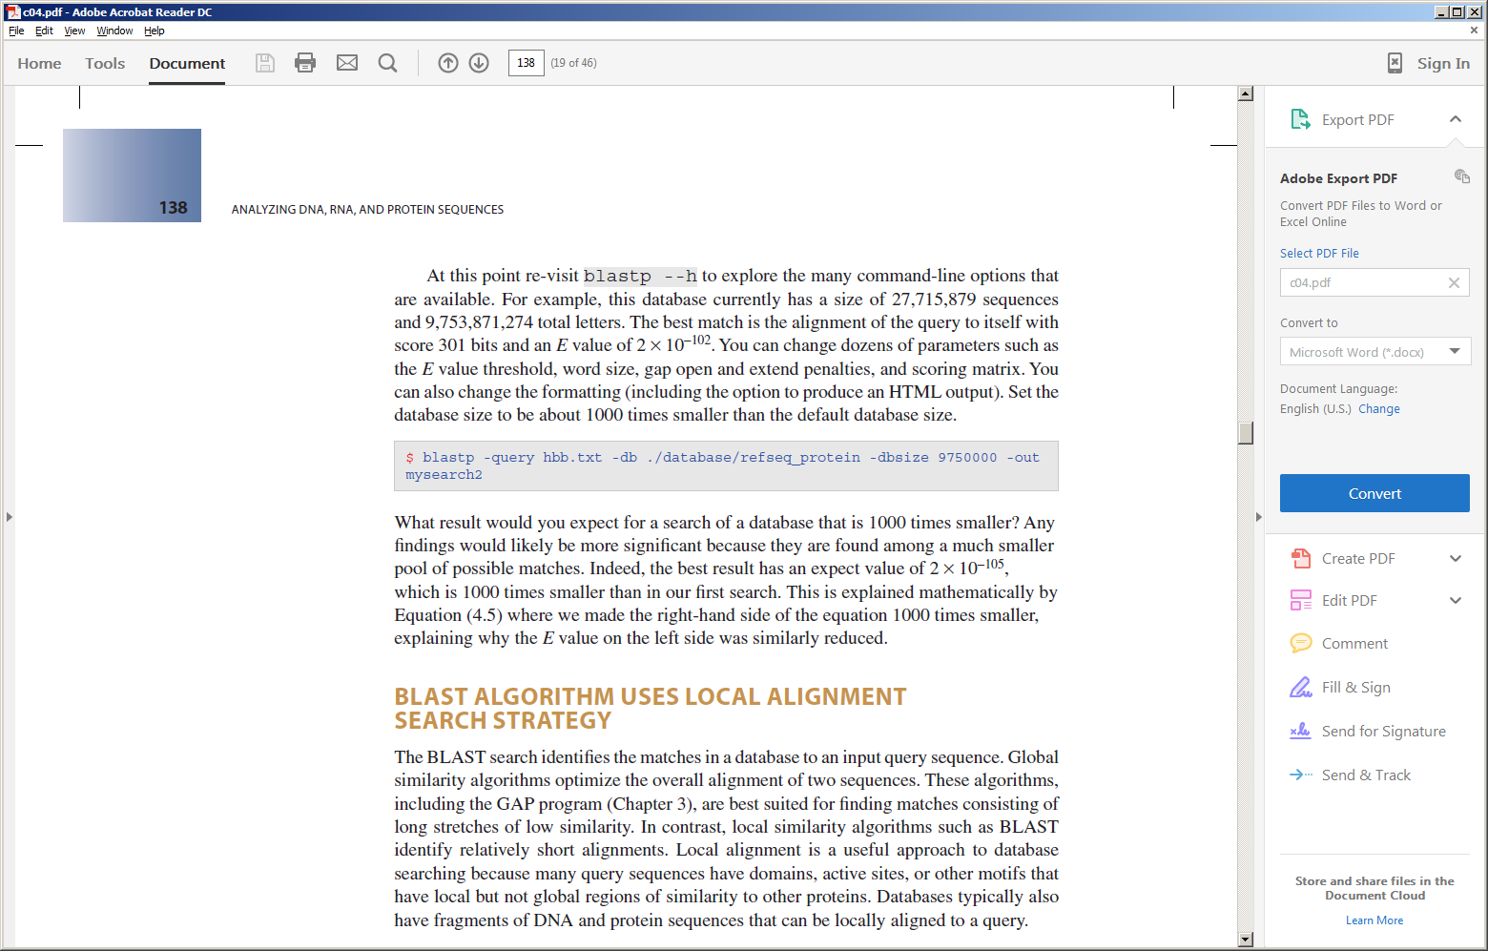
Command-line BLAST+ (Step 3: perform a search!)
Do the search:
View the results:
Try repeating the search, e.g. changing the database size:
B&FG 3e
Page 137

Slide 28
Outline
Introduction
BLAST search steps
Step 1: Specifying sequence of interest Step 2: Selecting BLAST program Step 3: Selecting a database Step 4: Selecting search parameters and formatting parameters
Stand-alone BLAST
BLAST algorithm uses local alignment search strategy
BLAST algorithm parts: list, scan, extend BLAST algorithm: local alignment search statistics and E value
Making sense of raw scores with bit scores BLAST algorithm: relation between E and p values
BLAST search strategies General concepts; principles of BLAST searching
How to evaluate the significance of results How to handle too many or too few results
BLAST searching with multidomain protein: HIV-1 Pol
Using BLAST for gene discovery: Find-a-Gene
Perspective

Slide 29
How a BLAST search works
“The central idea of the BLAST
algorithm is to confine attention
to segment pairs that contain a
word pair of length w with a score
of at least T.”
Altschul et al. (1990)

Slide 30
How the original BLAST algorithm works:
three phases
Phase 1: compile a list of word pairs (w=3)
above threshold T
Example: for a human RBP query
…FSGTWYA… (query word is in green)
A list of words (w=3) is:
FSG SGT GTW TWY WYA
YSG TGT ATW SWY WFA
FTG SVT GSW TWF WYS
...

Slide 31
Phase 1: compile a list of words (w=3)
GTW 6,5,11 22
neighborhood GSW 6,1,11 18
word hits ATW 0,5,11 16
> threshold NTW 0,5,11 16
GTY 6,5,2 13
GNW 10
neighborhood GAW 9
word hits
< below threshold
(T=11)
Fig. 4.11
page 116

Slide 32
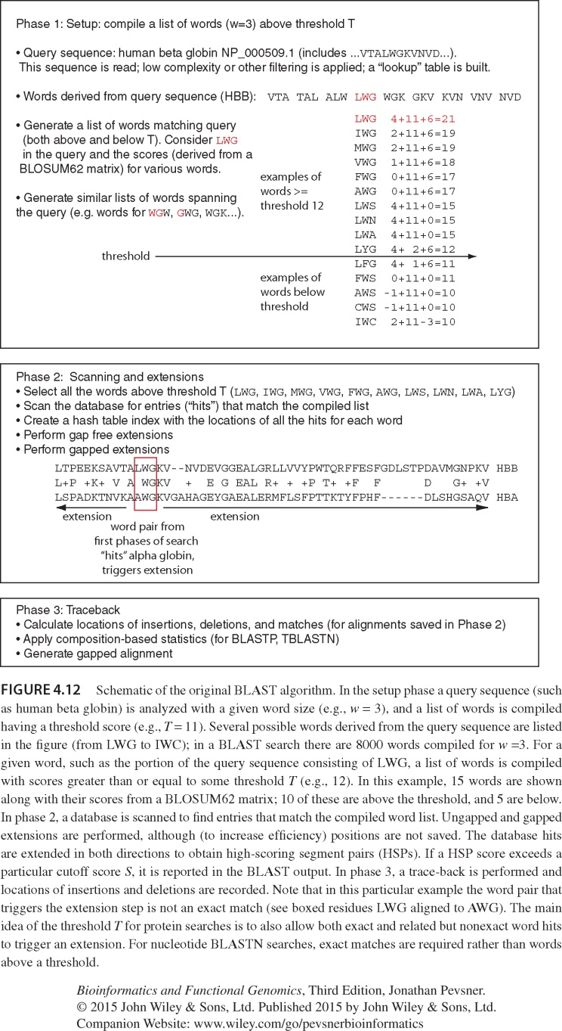
B&FG 3e
Fig. 4-12
Page 139

Slide 33
Phase 2: scan the database for matches and extend
B&FG 3e
Fig. 4-12
Page 139

Slide 34
Phase 3: Traceback to generate gapped alignment
B&FG 3e
Fig. 4-12
Page 139

Slide 35
How a BLAST search works: threshold
You can locally install BLAST and modify the threshold parameter.
The default value for BLASTP is 11.
To change it, enter “-f 16” or “-f 5” in the
advanced options of BLAST+.

Slide 36
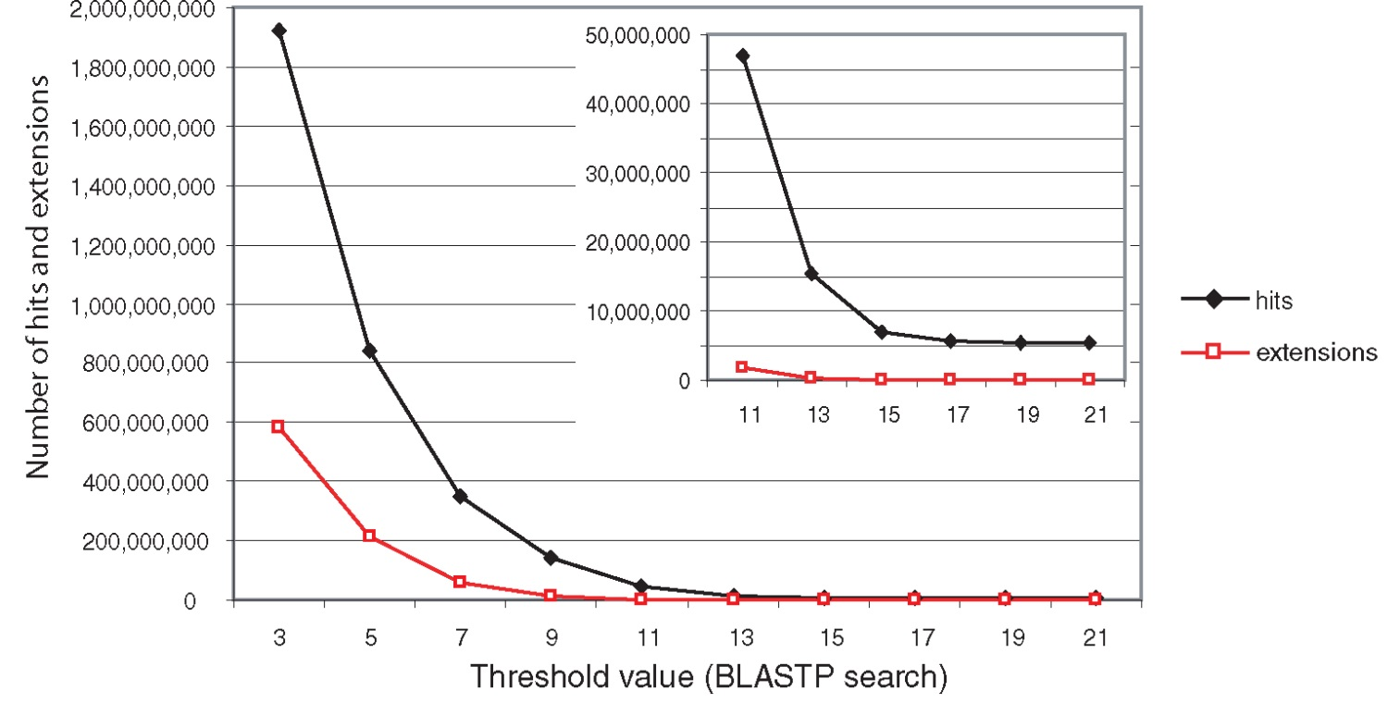
Effect of changing the threshold T: Lower T yields more database hits (black line) and extensions (red)
B&FG 3e
Fig. 4-13
Page 140

Slide 37
For BLASTN, the word size is typically 7, 11, or 15 (EXACT match). Changing word size is like changing threshold of proteins. w=15 gives fewer matches and is faster than w=11 or w=7.
For megaBLAST (see below), the word size is 28 and can be adjusted to 64. What will this do? MegaBLAST is VERY fast for finding closely related DNA sequences!

Slide 38
How to interpret a BLAST search: expect value
It is important to assess the statistical significance
of search results.
For global alignments, the statistics are poorly understood.
For local alignments (including BLAST search results),
the statistics are well understood. The scores follow
an extreme value distribution (EVD) rather than a
normal distribution.

Slide 39
Normal distribution
0.40
0.35
0.30
0.25
normal
distribution
probability
0.20
0.15
0.10
0.05
0
-5
-4
-3
-2
-1
0
1
2
3
4
x

Slide 40
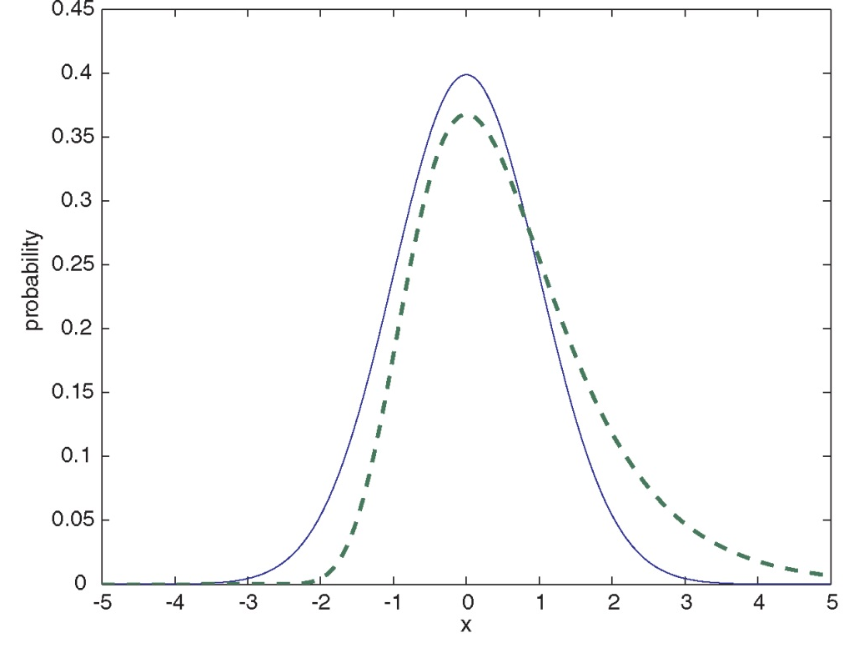
Normal distribution (solid line) compared to extreme value distribution (dashed line): note EVD skewing to the right
B&FG 3e
Fig. 4-14
Page 141

Slide 41
How to interpret a BLAST search: expect value
The expect value E is the number of alignments
with scores greater than or equal to score S
that are expected to occur by chance in a
database search.
An E value is related to a probability value p.
The key equation describing an E value is:
E = Kmn e^{-λS}

Slide 42
E = Kmn e^{-λS}
This equation is derived from a description
of the extreme value distribution
S = the score
E = the expect value = the number of high-
scoring segment pairs (HSPs) expected
to occur with a score of at least S
m, n = the length of two sequences
λ, K = Karlin Altschul statistics

Slide 43
Some properties of the equation E = Kmn e^{-λS}
The value of E decreases exponentially with increasing S
(higher S values correspond to better alignments). Very
high scores correspond to very low E values.
The E value for aligning a pair of random sequences must
be negative! Otherwise, long random alignments would
acquire great scores
Parameter K describes the search space (database).
For E=1, one match with a similar score is expected to
occur by chance. For a very much larger or smaller
database, you would expect E to vary accordingly

Slide 44
From raw scores to bit scores
There are two kinds of scores: raw scores (calculated from a substitution matrix) and bit scores (normalized scores)
Bit scores are comparable between different searches because they are normalized to account for the use of different scoring matrices and different database sizes
S’ = bit score = (λS - lnK) / ln2
The E value corresponding to a given bit score is:
E = mn 2 ^{-S’}
Bit scores allow you to compare results between different database searches, even using different scoring matrices.
B&FG 3e
Page 143

Slide 45
How to interpret BLAST: E values and p values
The expect value E is the number of alignments
with scores greater than or equal to score S
that are expected to occur by chance in a
database search. A p value is a different way of
representing the significance of an alignment.
p = 1 - e^{-E}
B&FG 3e
Page 143

Slide 46
How to interpret BLAST: E values and p values
E values of about 1 to 10 are far easier to interpret than corresponding p values.
__E ____p
10 0.99995460
5 0.99326205
2 0.86466472
1 0.63212056
0.1 0.09516258 (about 0.1)
0.05 0.04877058 (about 0.05)
0.001 0.00099950 (about 0.001)
0.0001 0.00010000
Very small E values are very similar to p values.
E values are comparable to p values, and are designed to be more convenient to interpret.

Slide 47
Outline
Introduction
BLAST search steps
Step 1: Specifying sequence of interest Step 2: Selecting BLAST program Step 3: Selecting a database Step 4: Selecting search parameters and formatting parameters
Stand-alone BLAST
BLAST algorithm uses local alignment search strategy
BLAST algorithm parts: list, scan, extend BLAST algorithm: local alignment search statistics and E value
Making sense of raw scores with bit scores BLAST algorithm: relation between E and p values
BLAST search strategies General concepts; principles of BLAST searching
How to evaluate the significance of results How to handle too many or too few results
BLAST searching with multidomain protein: HIV-1 Pol
Using BLAST for gene discovery: Find-a-Gene
Perspective

Slide 48
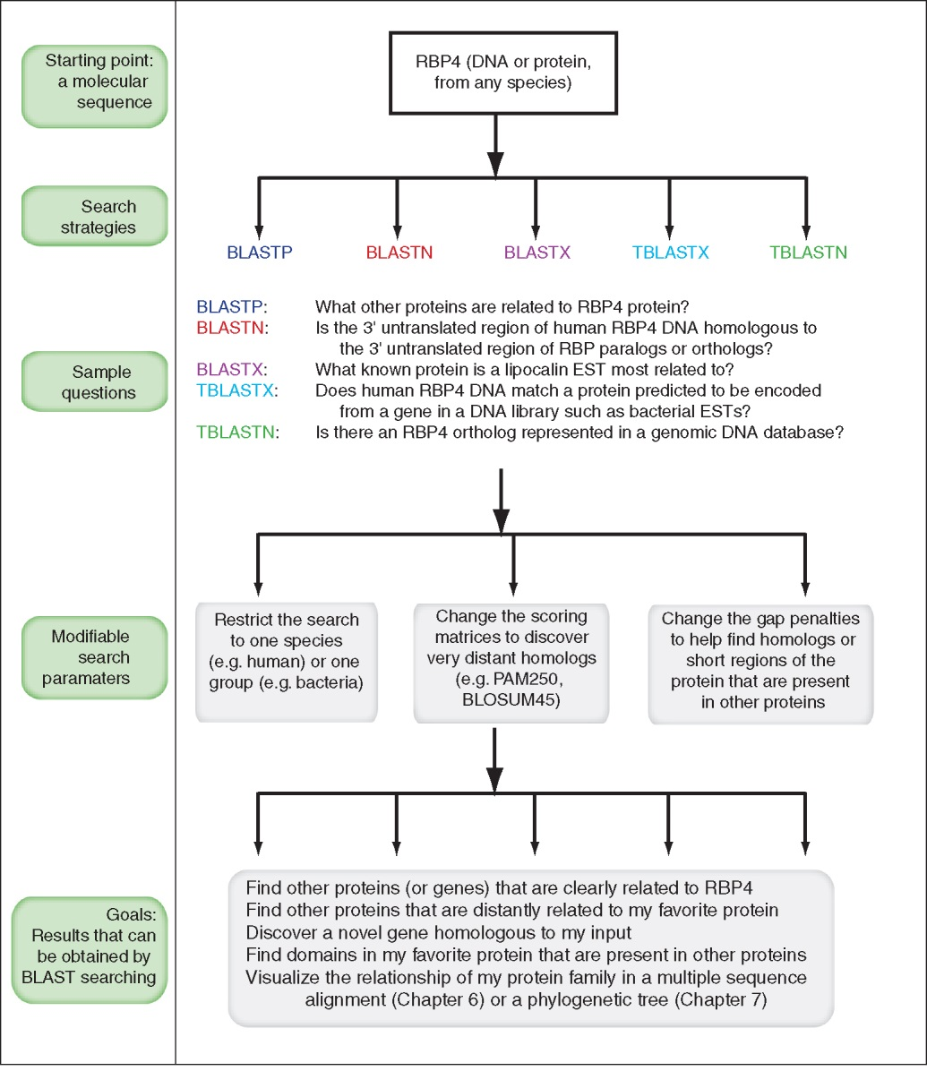
Overview of BLAST search strategies
B&FG 3e
Fig. 4-15
Page 145

Slide 49
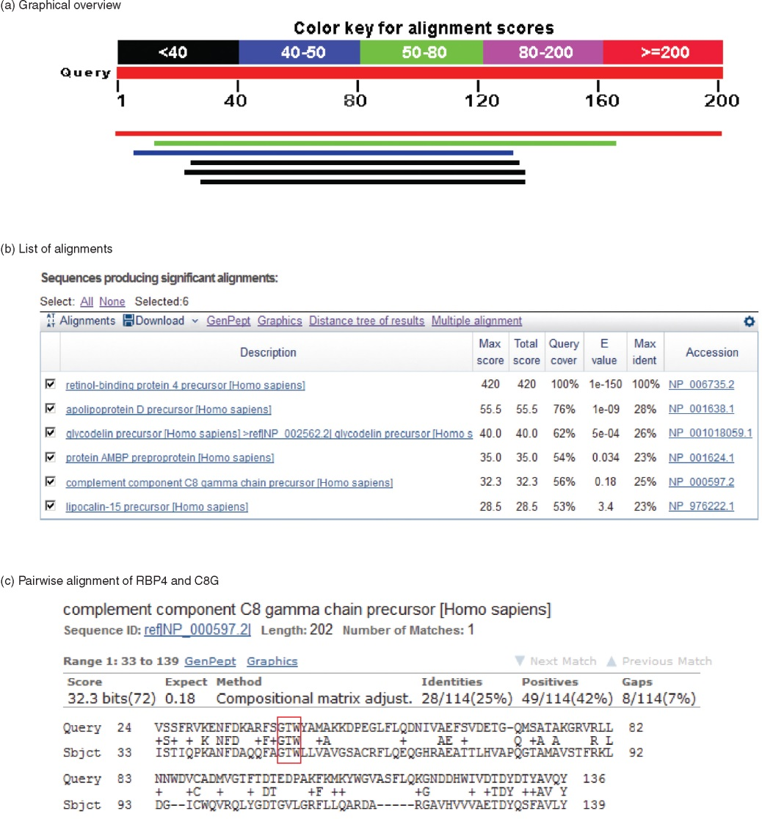
BLASTP search: human RBP4 query, human RefSeq database
Results include matches (such as CG8) with high E values and limited identity to the query
B&FG 3e
Fig. 4-16
Page 147

Slide 50
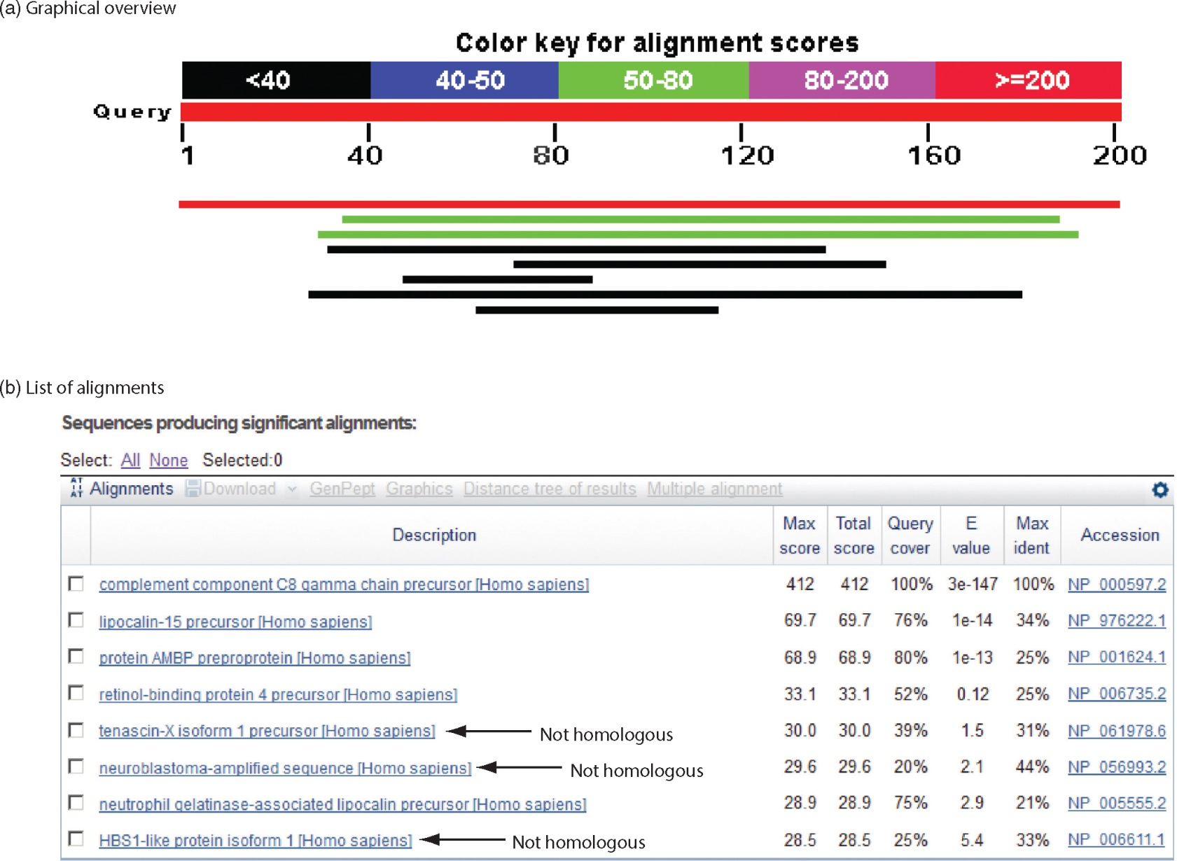
“Recipricol” BLASTP search with CG8 as query includes RBP4 and other lipocalins
B&FG 3e
Fig. 4-17
Page 149
This confirms that the finding of CG8 using RBP4 as a query was a true positive

Slide 51
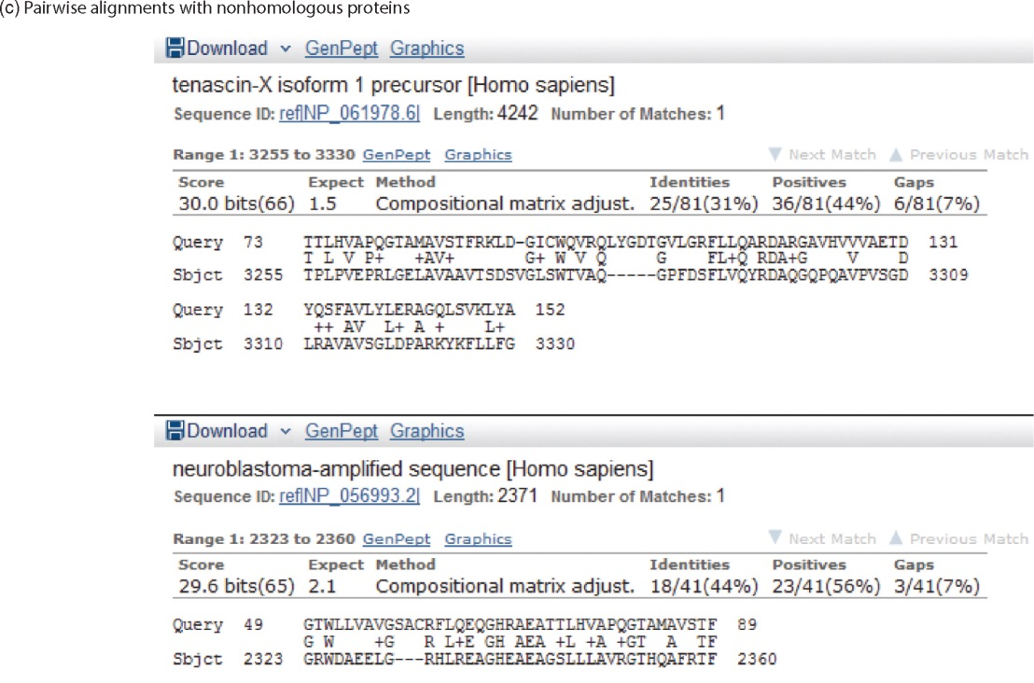
Pairwise alignment of CG8 with non-homologous proteins
Query and subject are very different lengths
E values are not significant
Matches lack GXW motif
Subjects are not annotated as lipocalins
B&FG 3e
Fig. 4-17
Page 149

Slide 52
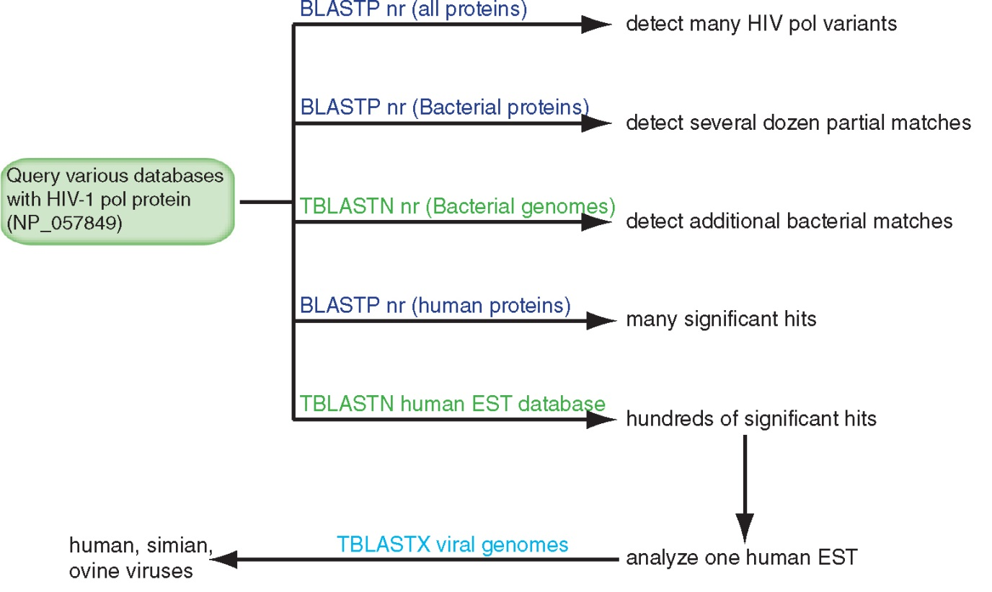
BLAST searching a multidomain protein: HIV-1 pol
B&FG 3e
Fig. 4-18
Page 151

Slide 53
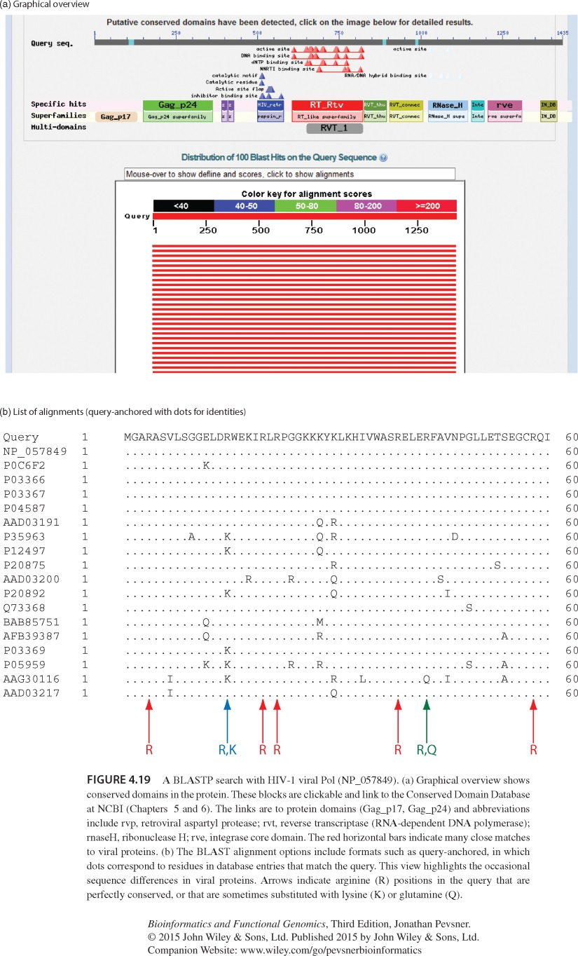
BLAST searching a multidomain protein: HIV-1 pol
The BLAST output includes a graphic of the various domains in HIV-1 pol
B&FG 3e
Fig. 4-19
Page 153

Slide 54
BLAST searching a multidomain protein: HIV-1 pol
This output shows identical residues as a dot (.). Note that the column positions that contain an arginine (R) can sometimes also contain a lysine (K) or glutamine (Q) in a position-specific pattern. This is a preview of the concept of position-specific scoring matrices (Chapter 5).
B&FG 3e
Fig. 4-19
Page 153

Slide 55
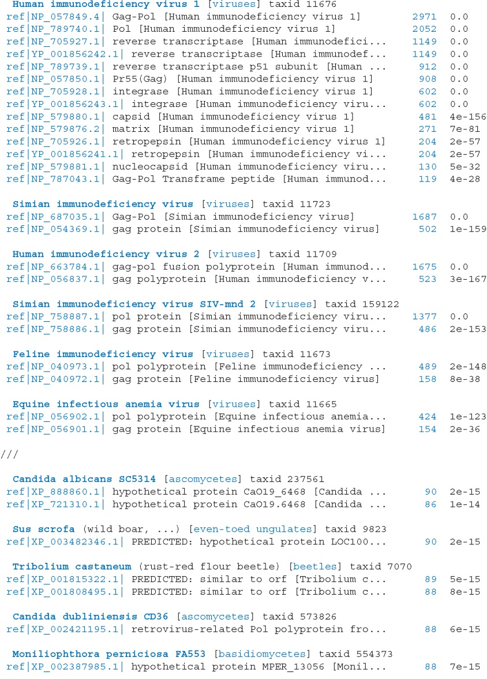
Taxonomy report for a BLAST searching HIV-1 pol
Most of the matches are to viruses, but there are also matches to rabbit, fungal, pig, and insect sequences.
B&FG 3e
Fig. 4-20
Page 154

Slide 56
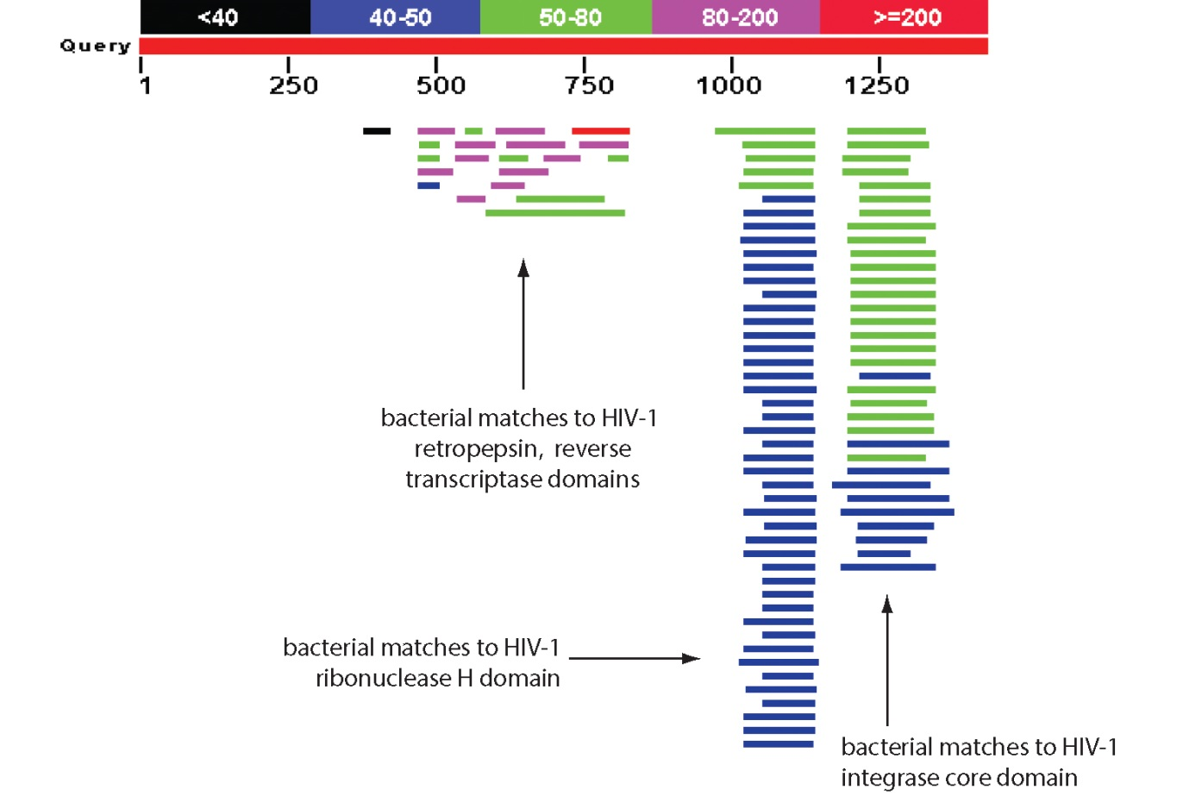
BLASTP searching HIV-1 pol against bacterial proteins
bacterial matches to HIV-1 retropepsin, reverse transcriptase domains
bacterial matches to HIV-1 ribonuclease H domain
bacterial matches to HIV-1 integrase core domain
B&FG 3e
Fig. 4-21
Page 155

Slide 57
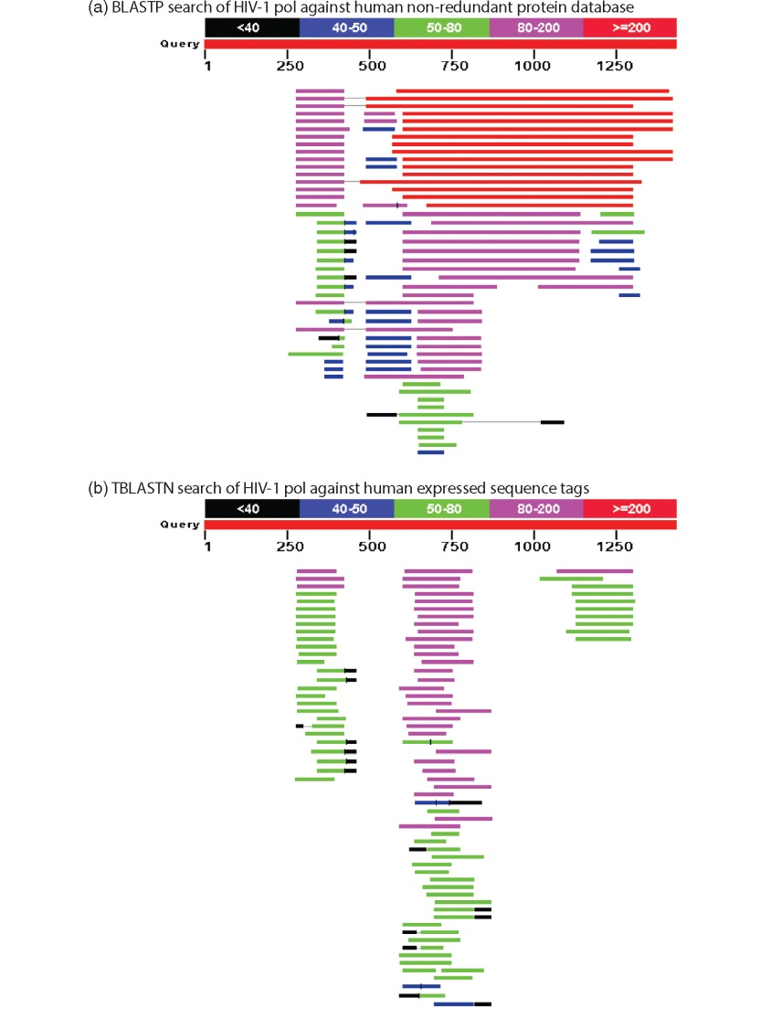
BLAST searching HIV-1 pol against human sequences
Question: are there human homologs of HIV-1 pol protein?
Query: HIV-1 Pol Program: BLASTP
Database: human nr (nonredundant) Matches: many human proteins share significant identity.
Question: are there human RNA transcripts corresponding to HIV-1 pol? Query: HIV-1 Pol Program: TBLASTN
Database: human ESTs Matches: many human genes are actively transcribed to generate transcripts homologous to HIV-1 pol.
B&FG 3e
Fig. 4-22
Page 156

Slide 58
Outline
Introduction
BLAST search steps
Step 1: Specifying sequence of interest Step 2: Selecting BLAST program Step 3: Selecting a database Step 4: Selecting search parameters and formatting parameters
Stand-alone BLAST
BLAST algorithm uses local alignment search strategy
BLAST algorithm parts: list, scan, extend BLAST algorithm: local alignment search statistics and E value
Making sense of raw scores with bit scores BLAST algorithm: relation between E and p values
BLAST search strategies General concepts; principles of BLAST searching
How to evaluate the significance of results How to handle too many or too few results
BLAST searching with multidomain protein: HIV-1 Pol
Using BLAST for gene discovery: Find-a-Gene
Perspective

Slide 59
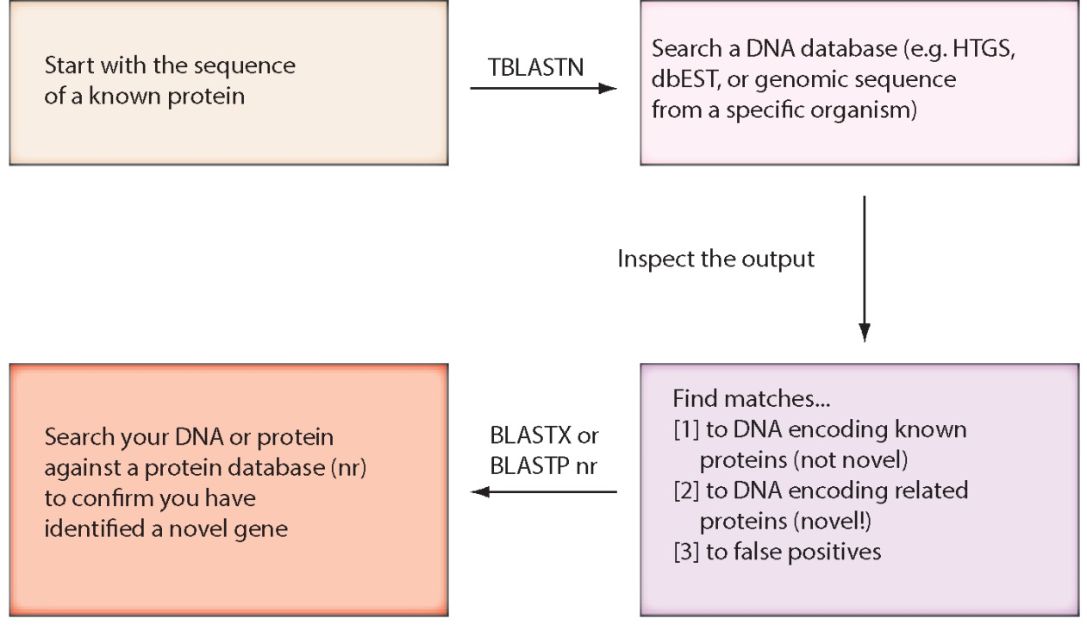
“Find-a-gene project” to practice BLAST
Start with the sequence of a known protein
TBLASTN
Inspect the output
BLASTX nr
or
BLASTP nr
B&FG 3e
Fig. 4-23
Page 157

Slide 60
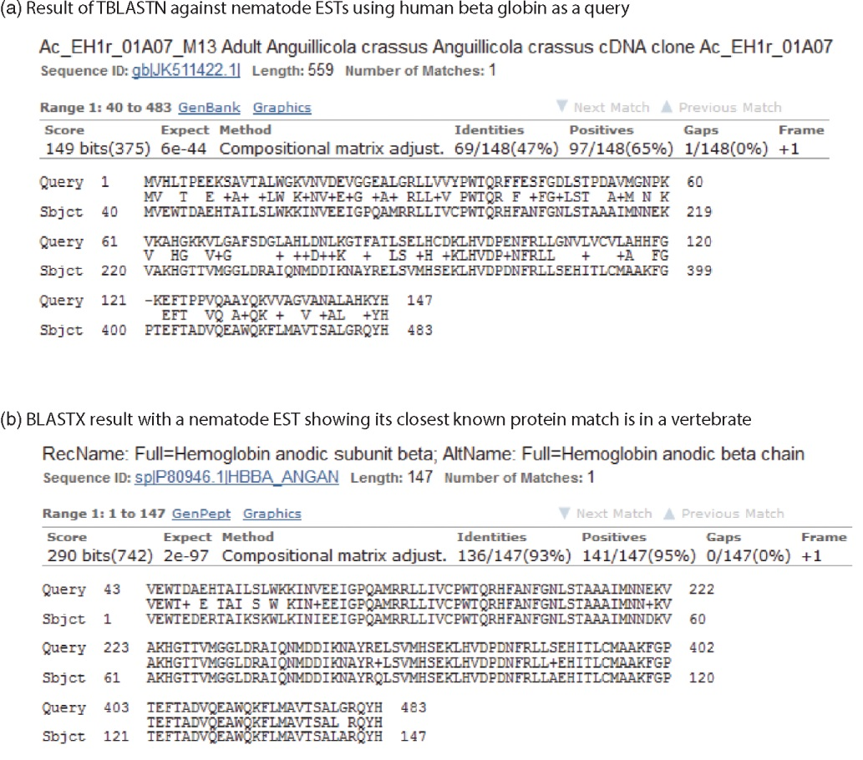
“Find-a-gene project” example: novel globin
Query: NP_000509 Program: TBLASTN
Database: EST (nematodes) Match: novel globin
Confirmation
Query: nematode EST Program: BLASTX Best match: a globin, but not a previously annotated globin
B&FG 3e
Fig. 4-24
Page 158

Slide 61
“Find-a-gene project”
The find-a-gene project is meant to be a very focused, specific project to help you understand how to use various BLAST tools (e.g. TBLASTN, BLASTX, BLASTP) and various databases.
You can start with (almost) any protein, from the organism of your choice, and discover a “novel” gene in another organism that is homologous but has never been annotated before as related to your query. Therefore you are discovering a new gene.
You can take your new gene/protein, name it, then search it against databases to confirm it has not been described before.
You can further perform multiple sequence alignment (Chapter 6), phylogeny (Chapter 7), and predict its protein structure (Chapter 13) and its function (Chapter 14).

Slide 62
Outline
Introduction
BLAST search steps
Step 1: Specifying sequence of interest Step 2: Selecting BLAST program Step 3: Selecting a database Step 4: Selecting search parameters and formatting parameters
Stand-alone BLAST
BLAST algorithm uses local alignment search strategy
BLAST algorithm parts: list, scan, extend BLAST algorithm: local alignment search statistics and E value
Making sense of raw scores with bit scores BLAST algorithm: relation between E and p values
BLAST search strategies General concepts; principles of BLAST searching
How to evaluate the significance of results How to handle too many or too few results
BLAST searching with multidomain protein: HIV-1 Pol
Using BLAST for gene discovery: Find-a-Gene
Perspective

Slide 63
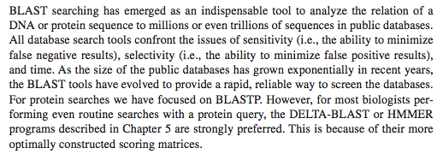
Perspective
B&FG 3e
Fig. 2-3
Page 22

